Slide 1

H2O for Internet of Things
Jo-fai (Joe) Chow
Data Scientist
joe@h2o.ai
@matlabulous
Data Science Milan
Politecnico di Milano
10th October, 2016

Slide 2
Agenda
First Talk (25 mins)
About H2O.ai
Demo
A Simple Classification Task
H2O’s Web Interface
Why H2O?
Our Community
Our Customers
What’s Next?
New H2O Features
Second Talk (25 mins)
H2O for IoT
Predictive Maintenance
Anomaly Detection
H2O’s R Interface
Third Talk (25 mins)
Deep Water
Demo
H2O + mxnet on GPU
H2O’s Python Interface

Slide 3
Data and Code
Please go to bit.ly/h2o_milan_1
subfolders
iot_use_case_1
iot_use_case_2

Slide 4
Use Case 1
Predictive Maintenance

Slide 5
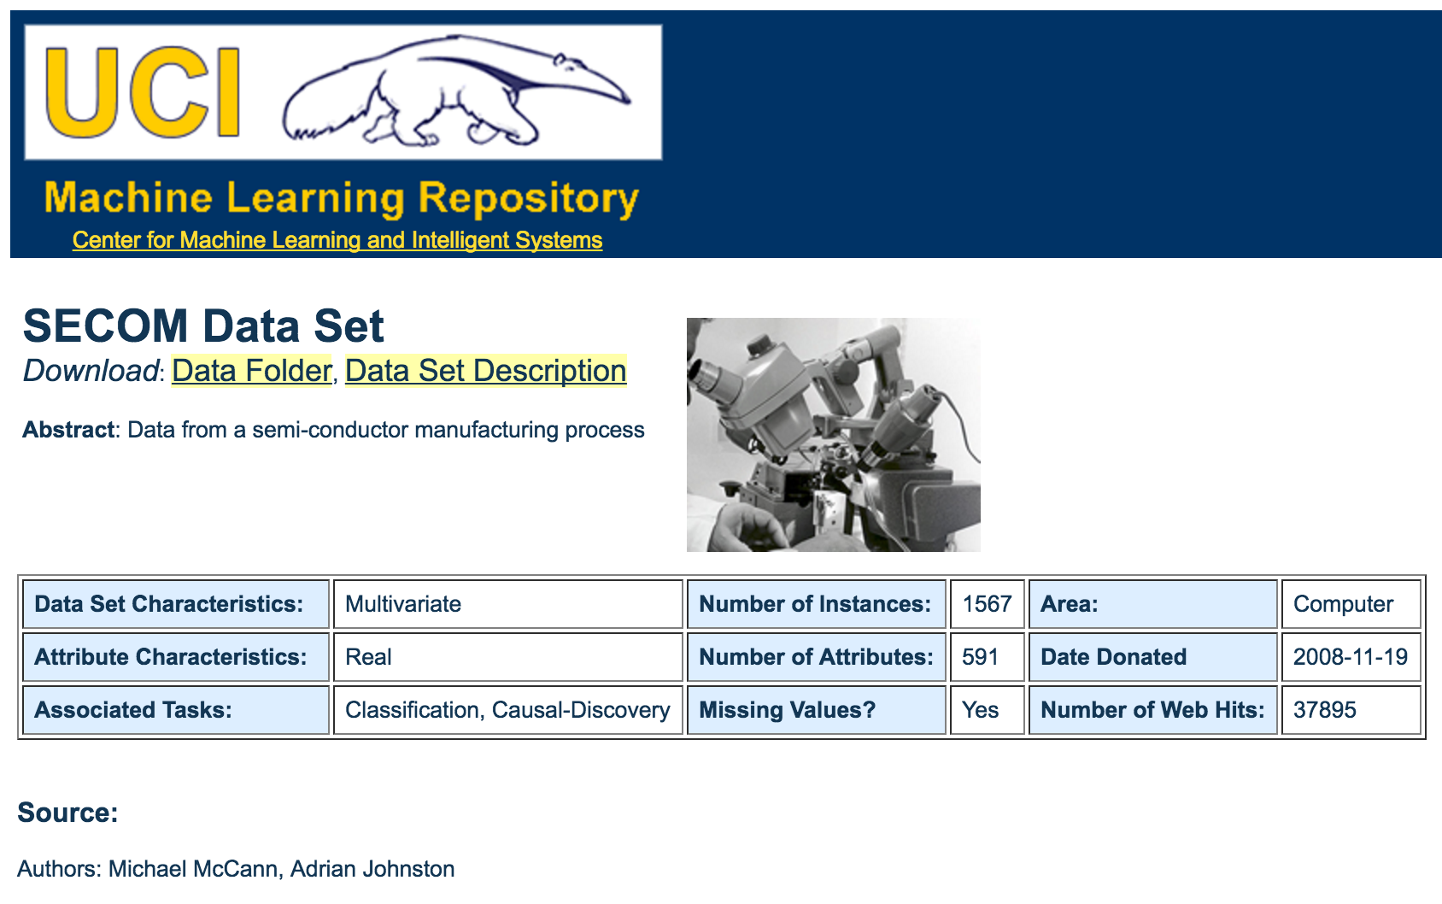
Data for Use Case 1: SECOM
https://archive.ics.uci.edu/ml/datasets/SECOM

Slide 6
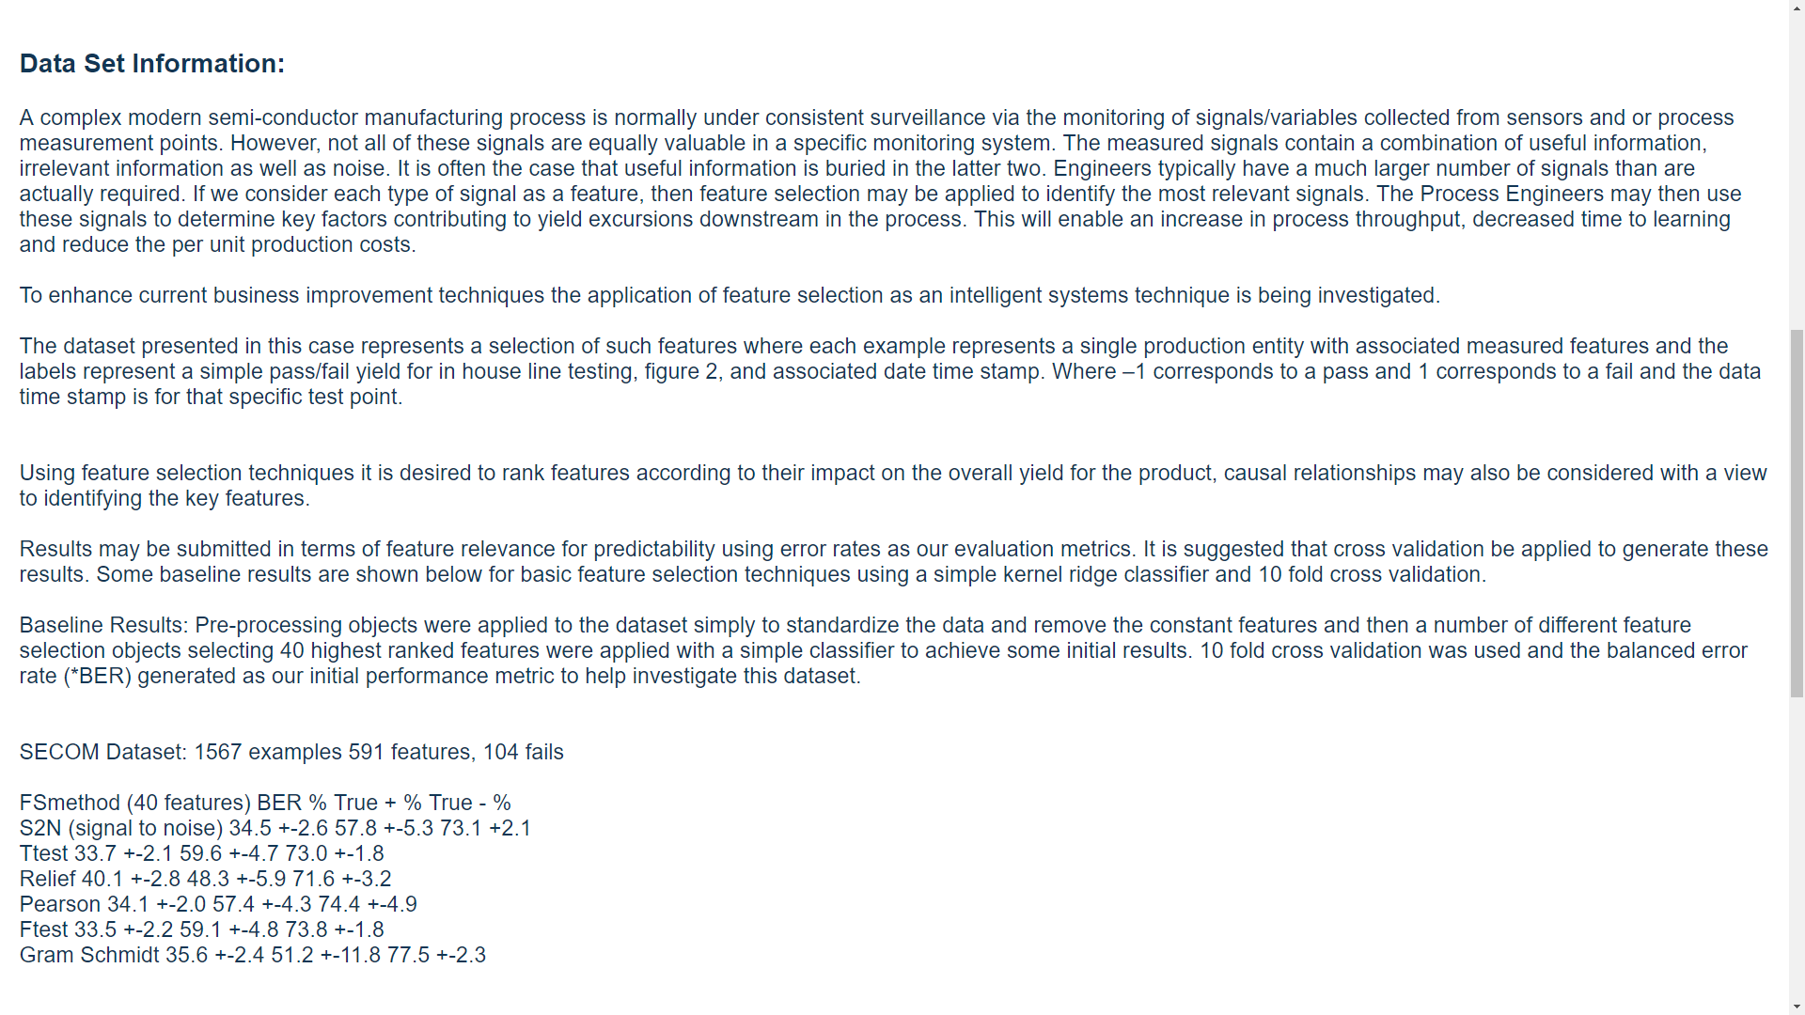
We want to predict fails in the future.

Slide 7

The ML Problem – Pass/Fail
Inputs
591 features
Output
Classification
-1 = pass
1 = fail
Size: 1567 Samples

Slide 8
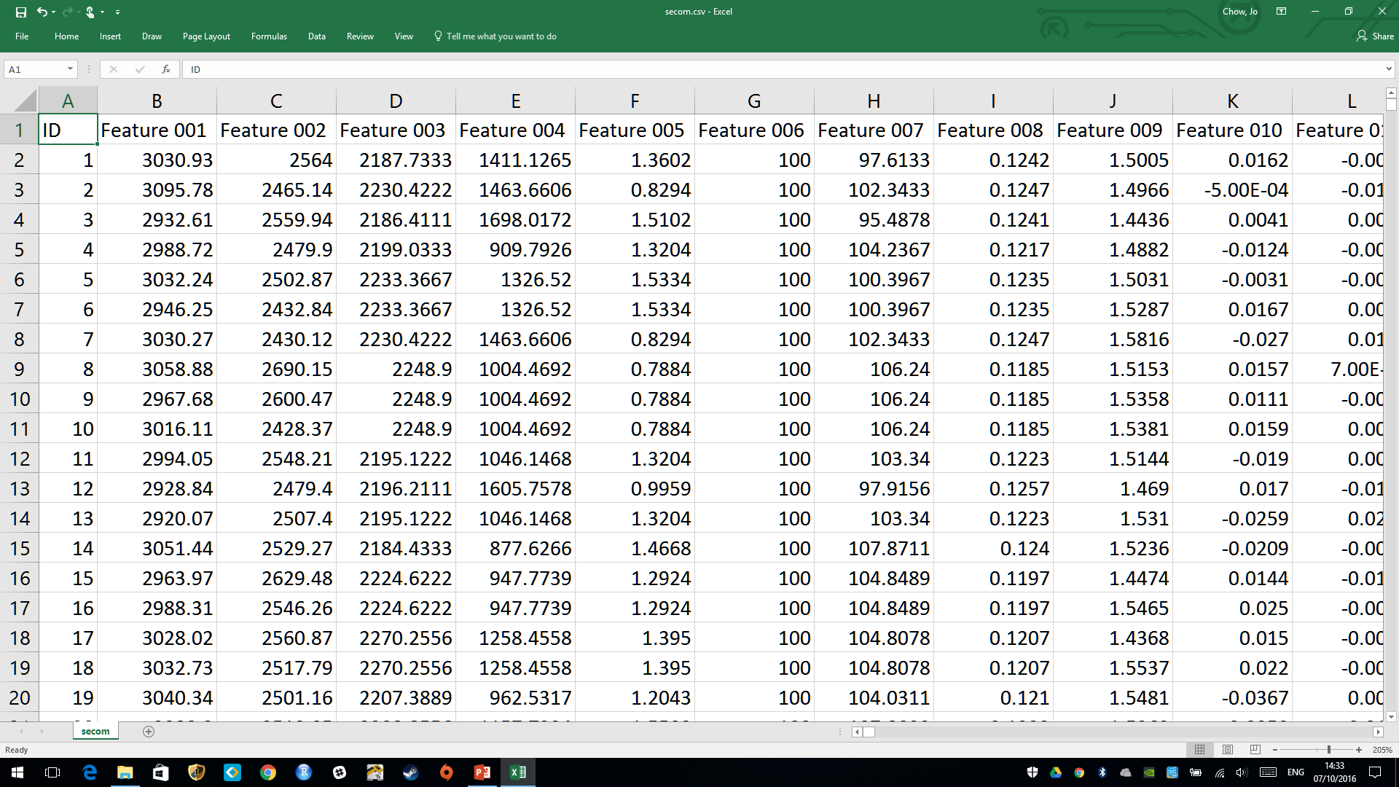
Features (Numeric)
ID (excluded from modeling)

Slide 9
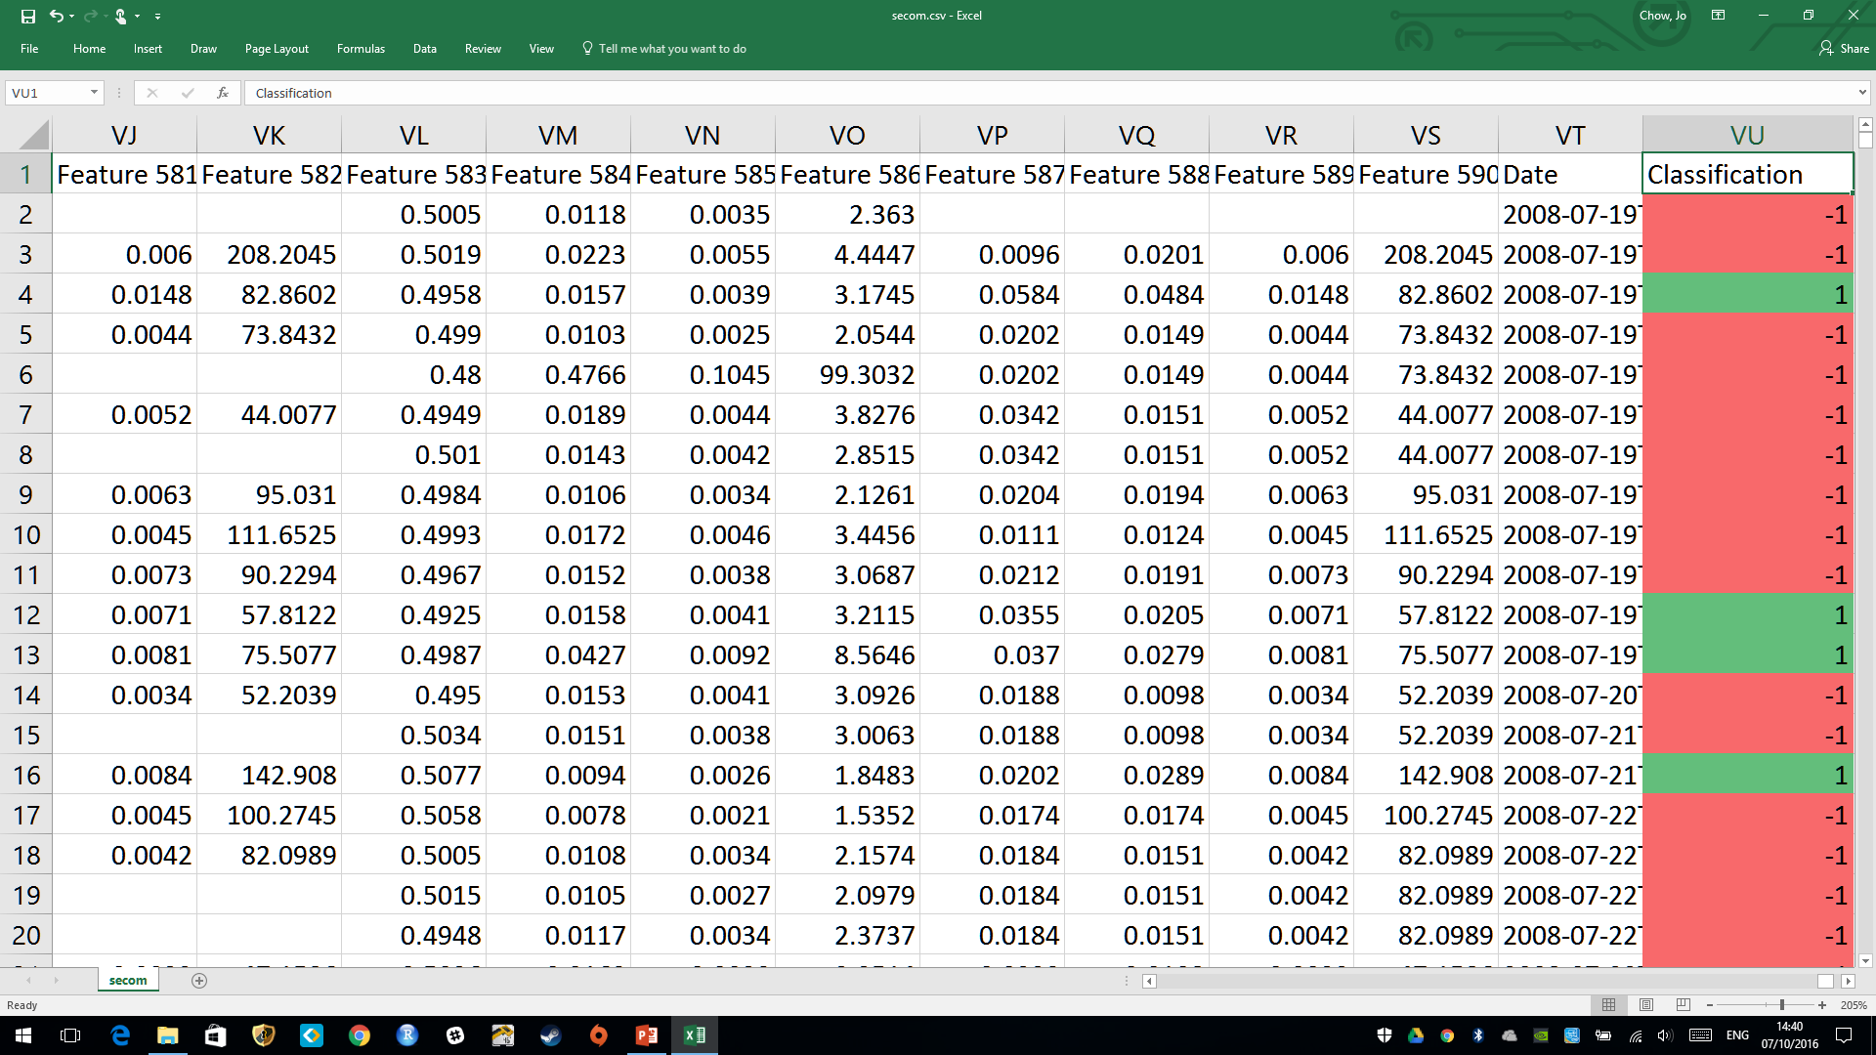
Features (Numeric)
Response (Classification)
-1 (Pass) or 1 (Fail)

Slide 10
Use Case 1: Predictive Maintenance
Step 1: R Packages

Slide 11
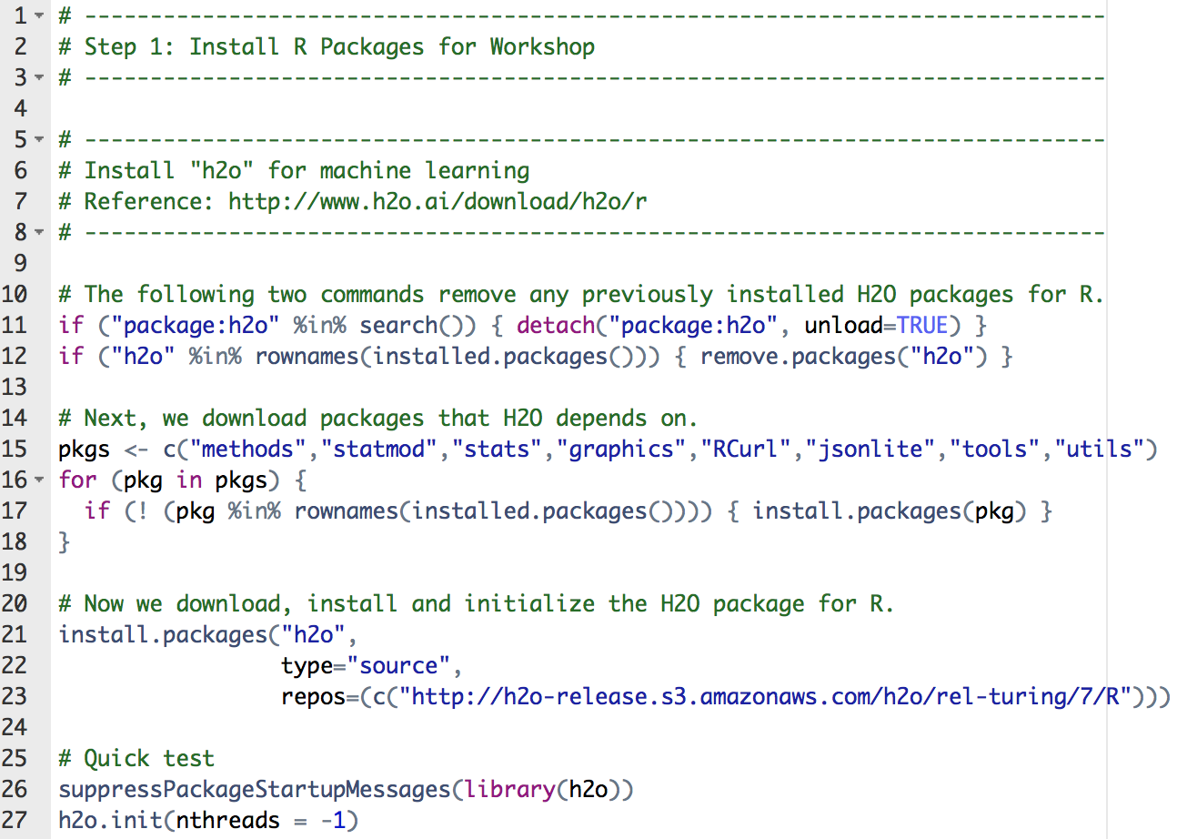
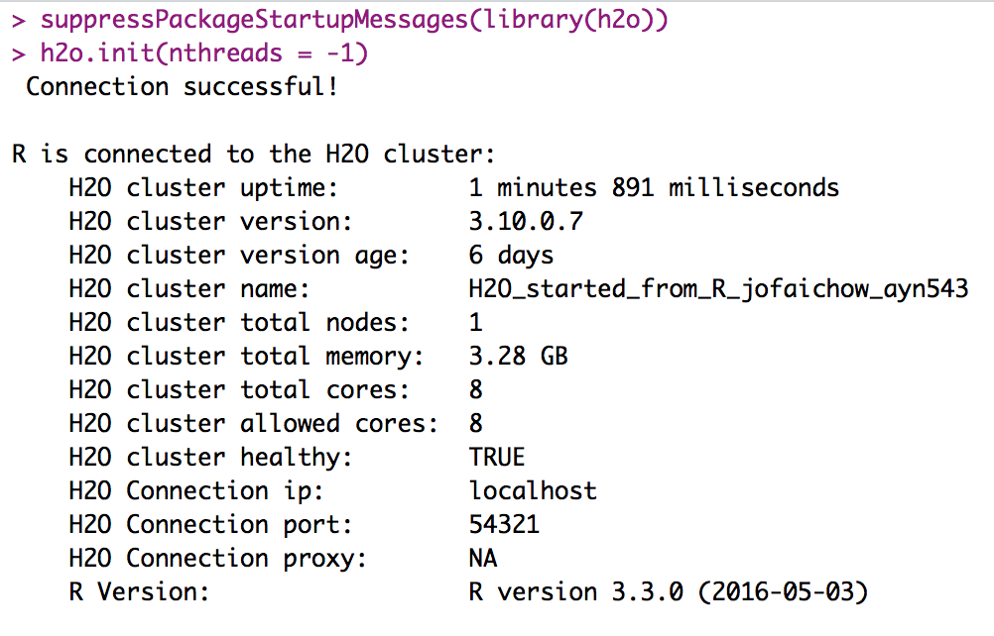
step_01_install_packages.R
Package ‘h2o’

Slide 12
Use Case 1: Predictive Maintenance
Step 2: Exploratory Analysis

Slide 13
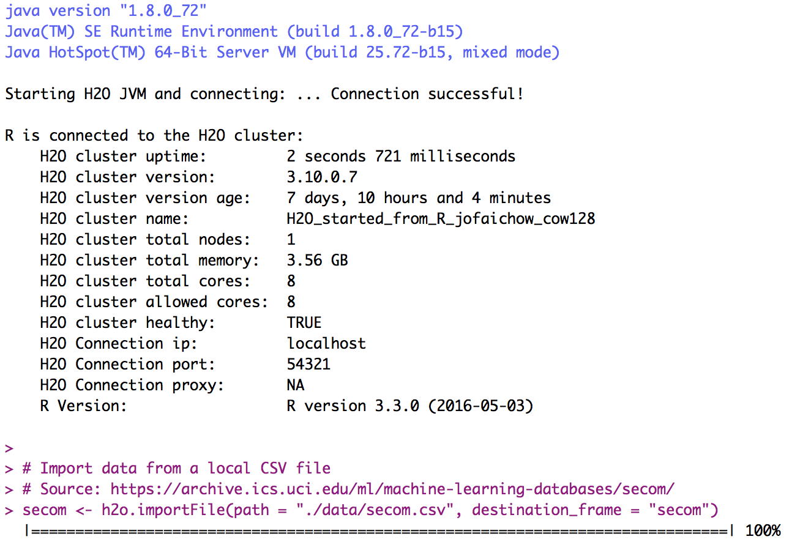
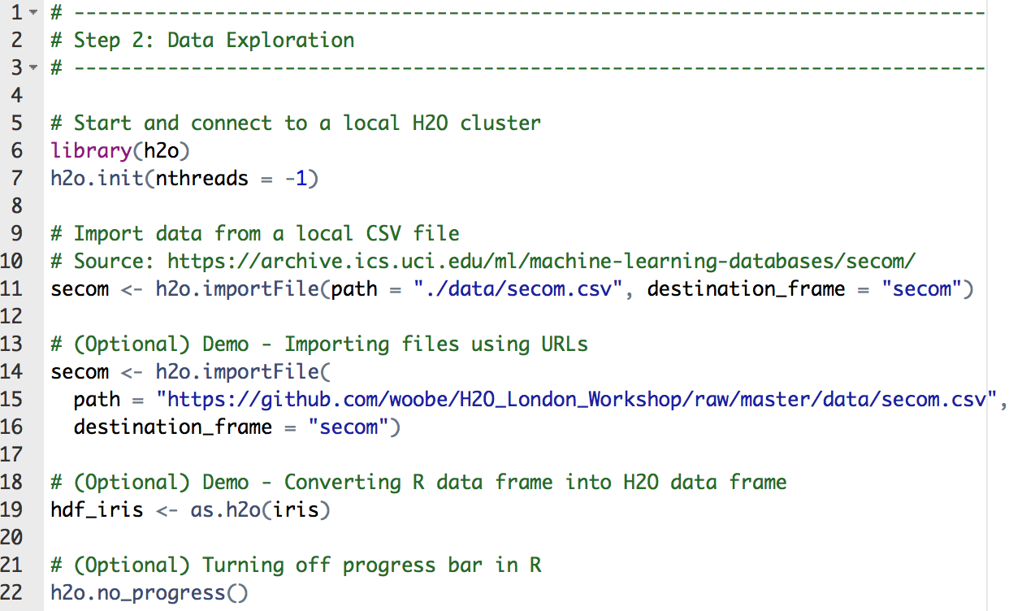
step_02_exploratory_analysis.R
Importing SECOM data
Optional (different ways to import data)

Slide 14
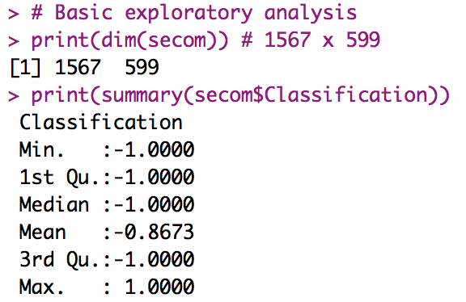
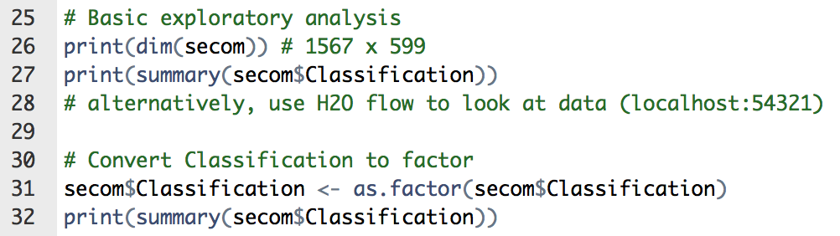
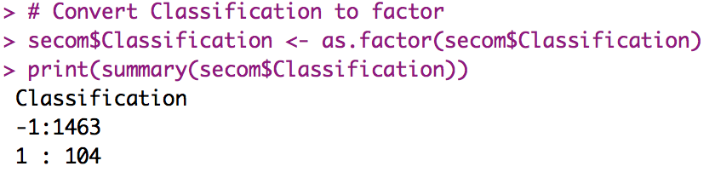
step_02_exploratory_analysis.R
Basic exploratory analysis
Convert -1 and 1 to categorical value
Note: Imbalance dataset (only 104 fails)

Slide 15
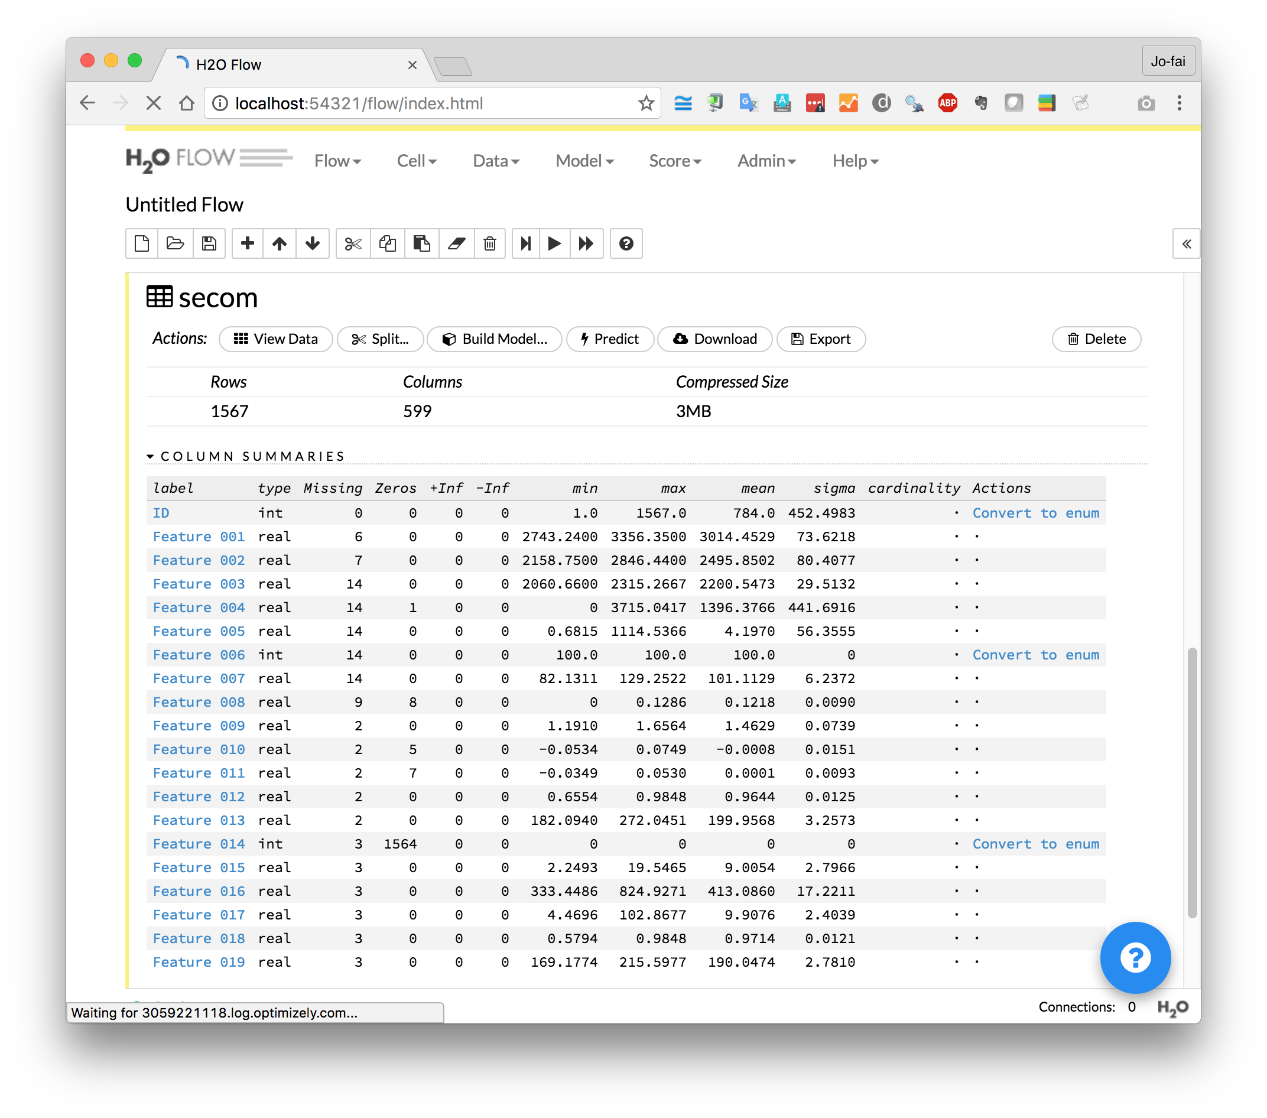
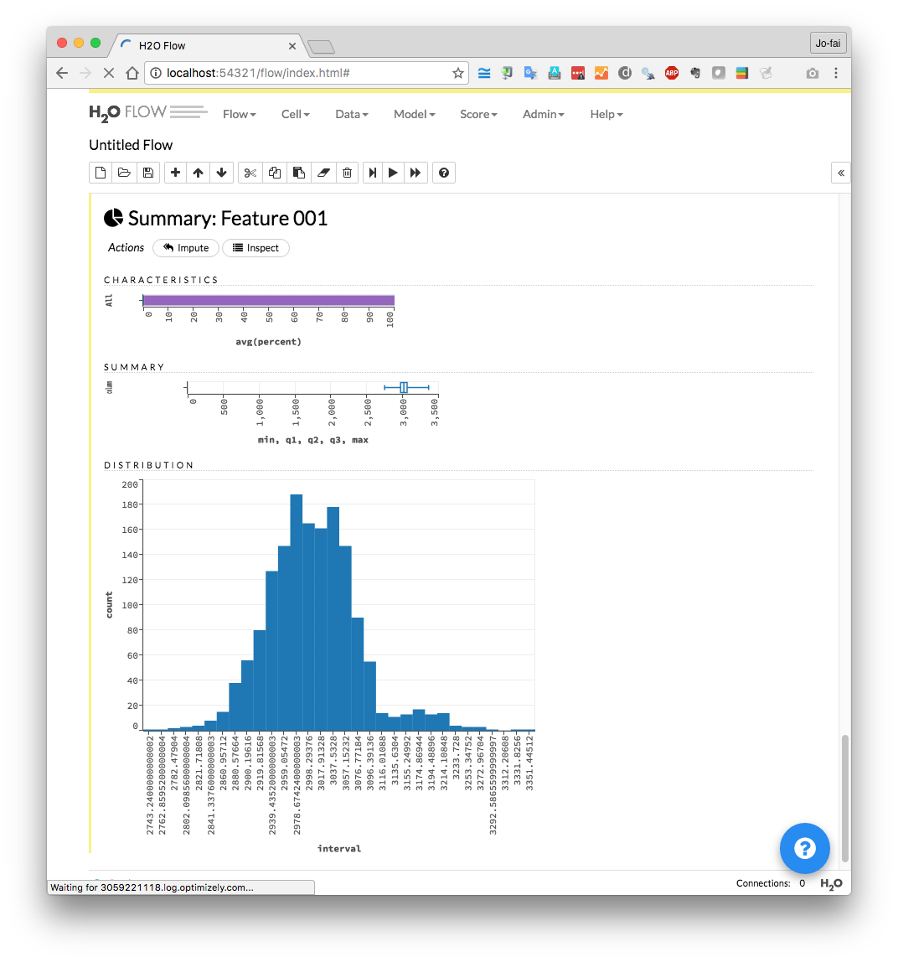
Use H2O Flow (localhost:54321)

Slide 16
Use Case 1: Predictive Maintenance
Step 3: Building & Evaluating Models

Slide 17
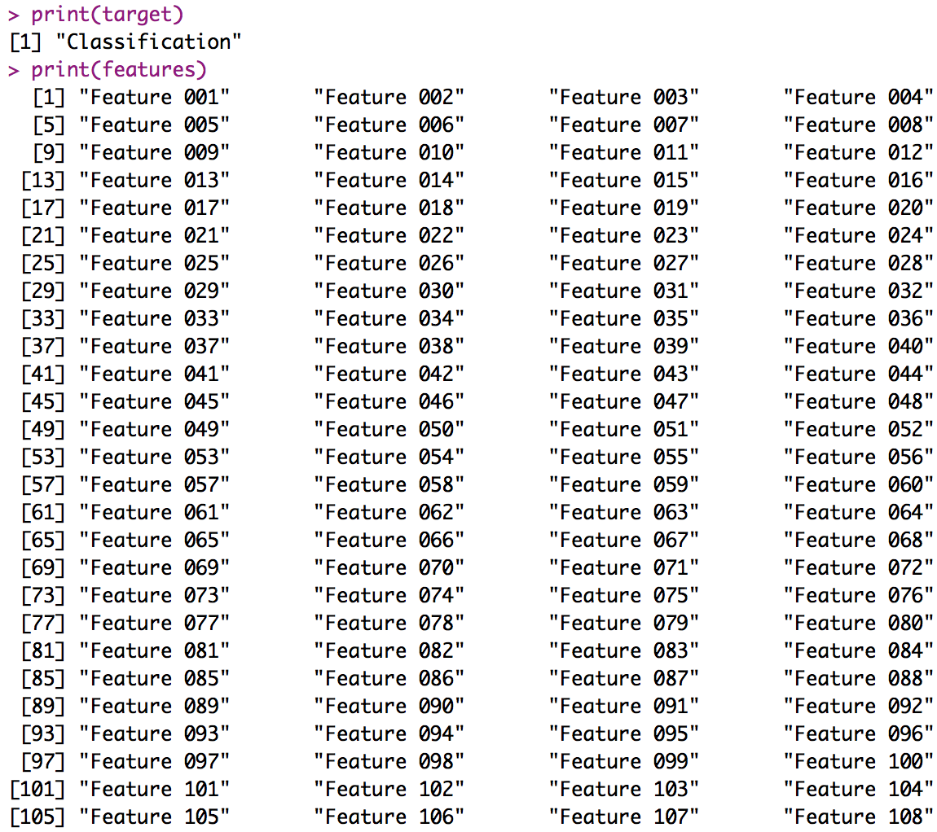
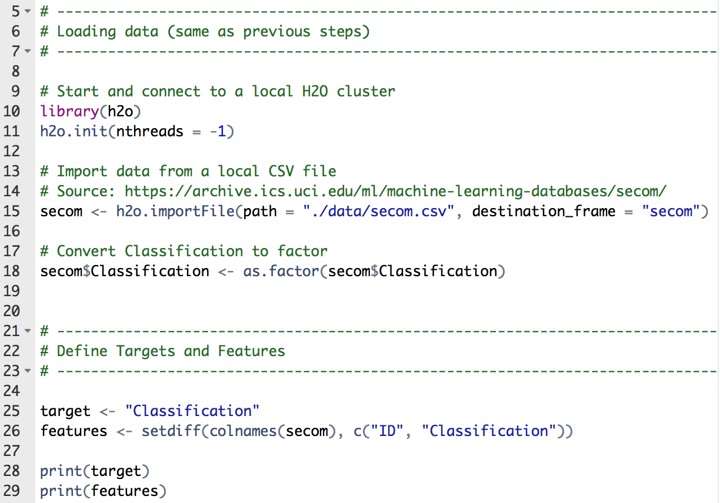
step_03_basic_models.R
Define features & target

Slide 18
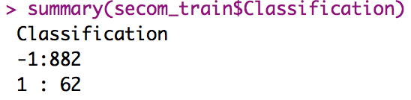
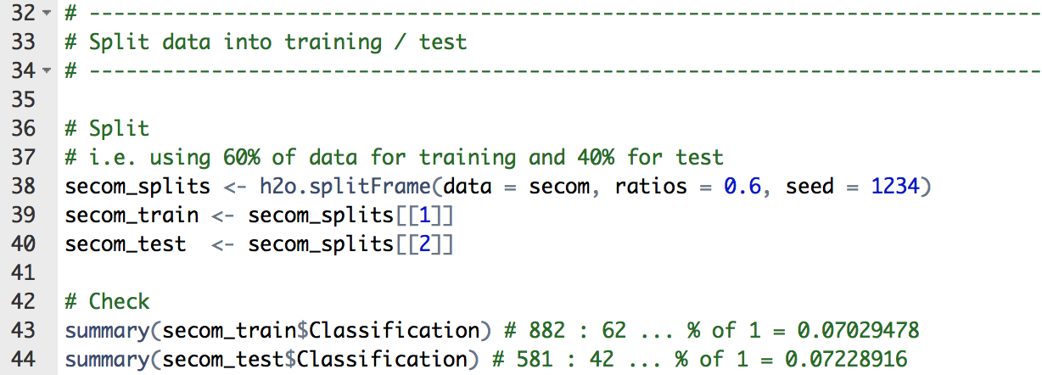
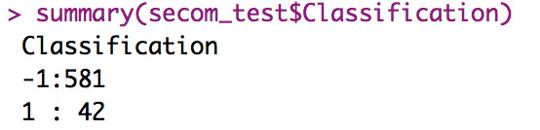
step_03_basic_models.R
Split data with a random seed
Classification 1 samples ≈ 7%

Slide 19
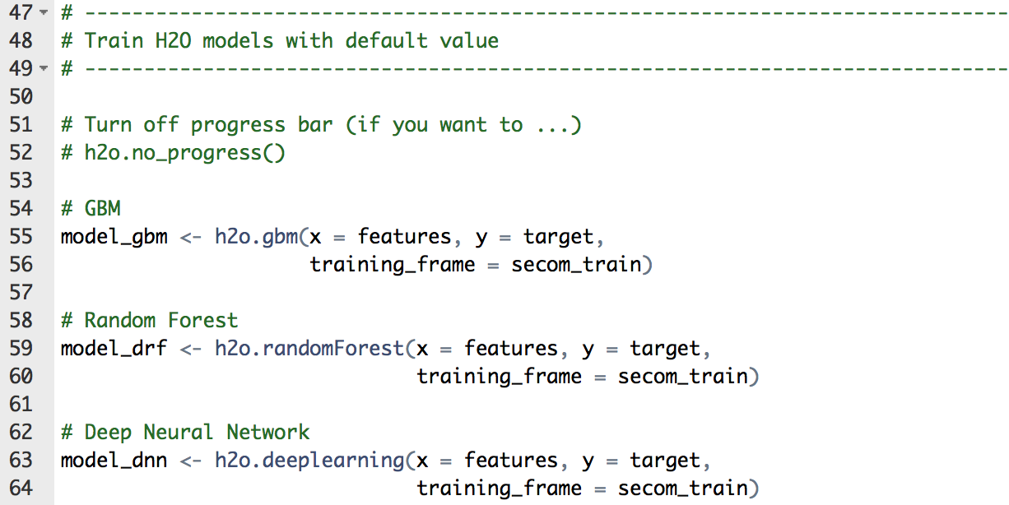
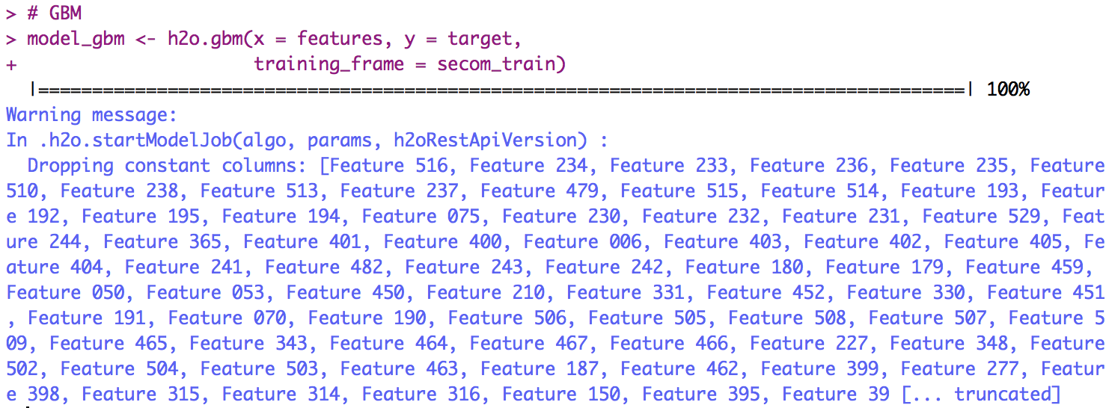
step_03_basic_models.R
Train H2O models with default values
H2O automatically ignores
Columns with constant values

Slide 20
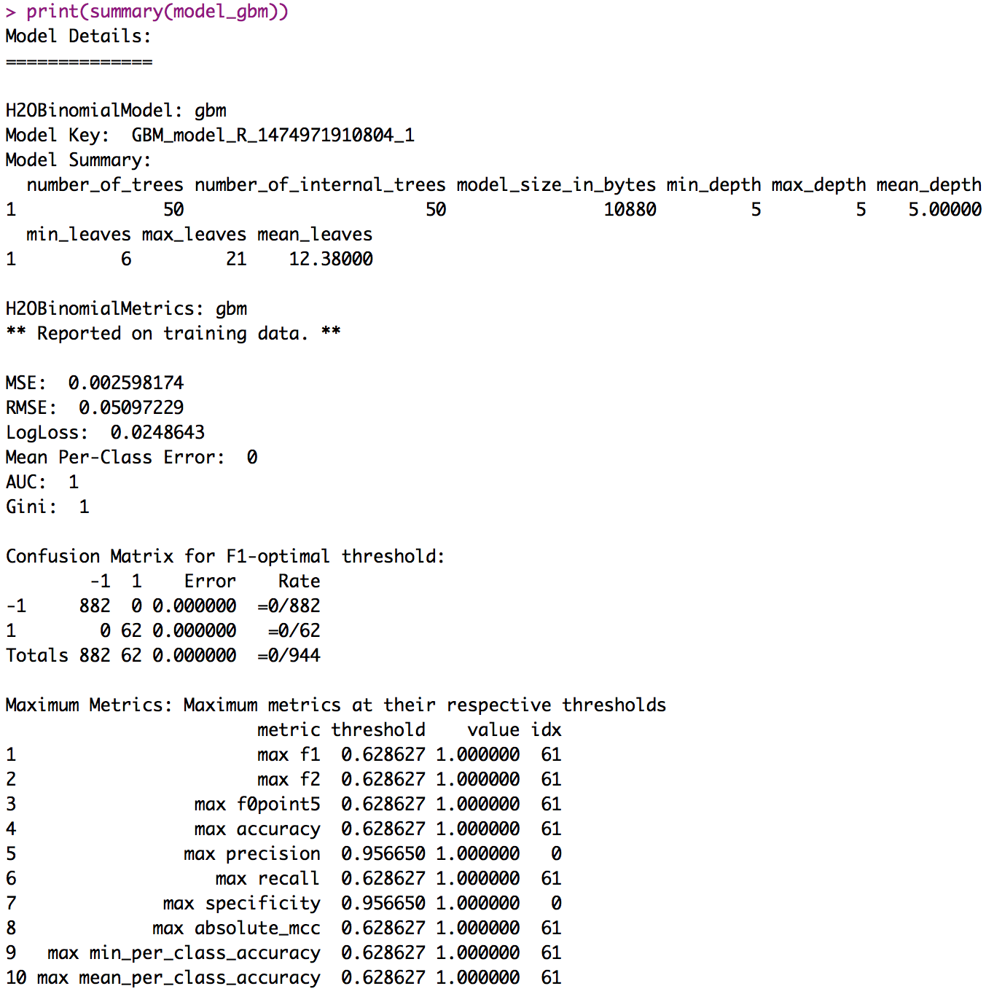
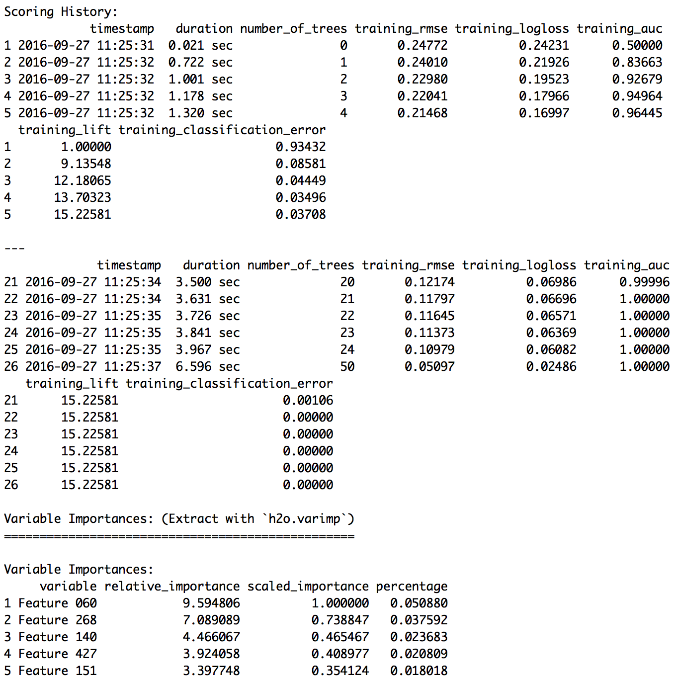
step_03_basic_models.R
summary(model_xxx)

Slide 21
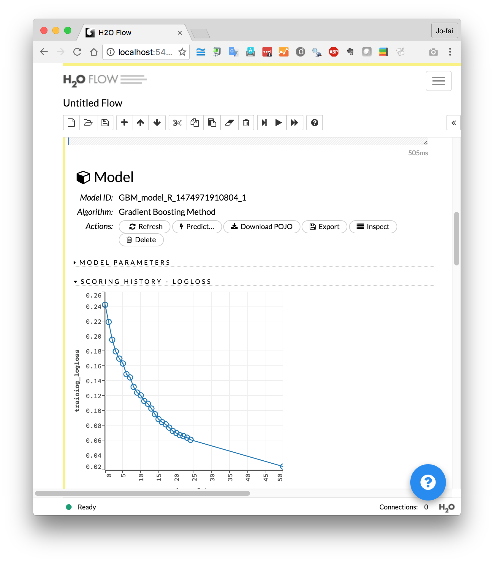
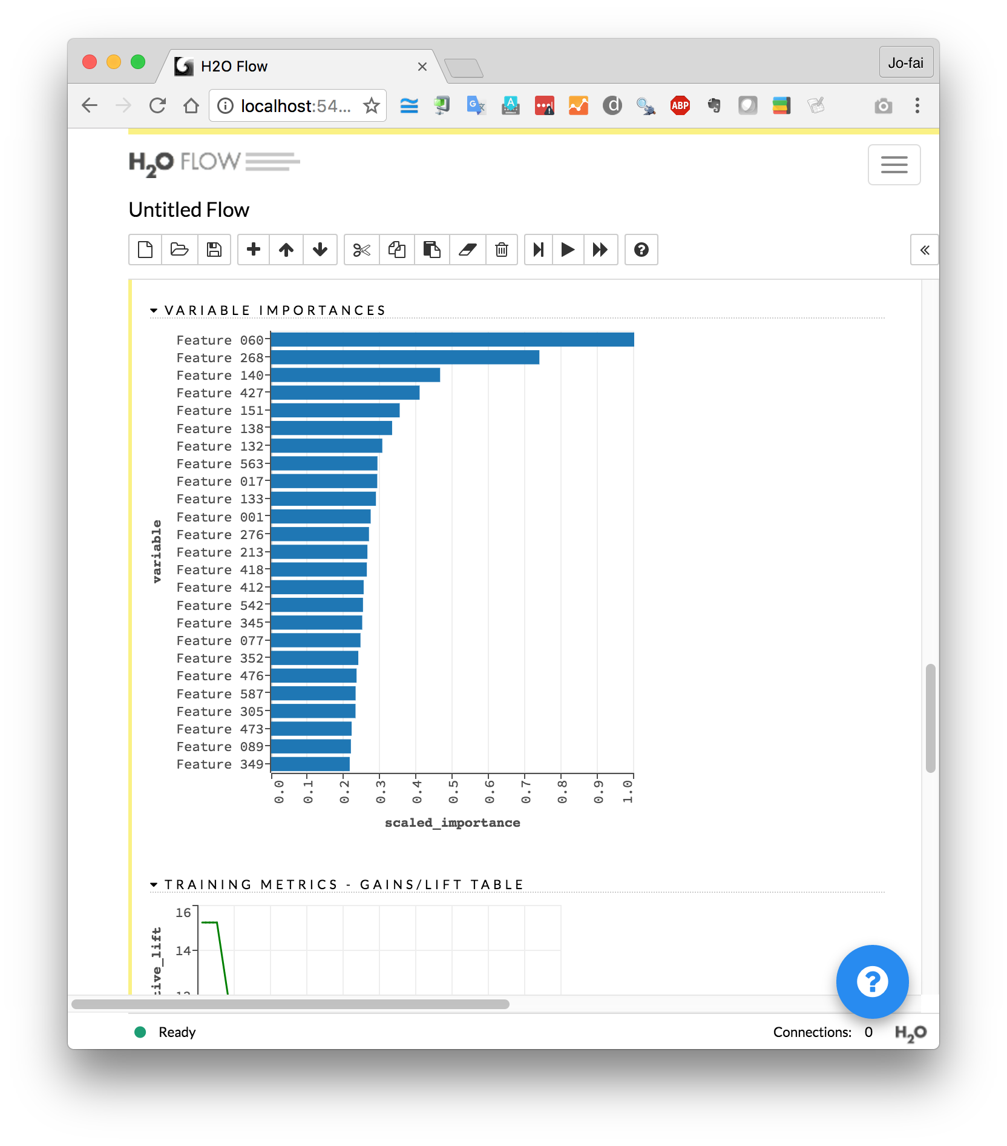
Use H2O Flow (localhost:54321)

Slide 22
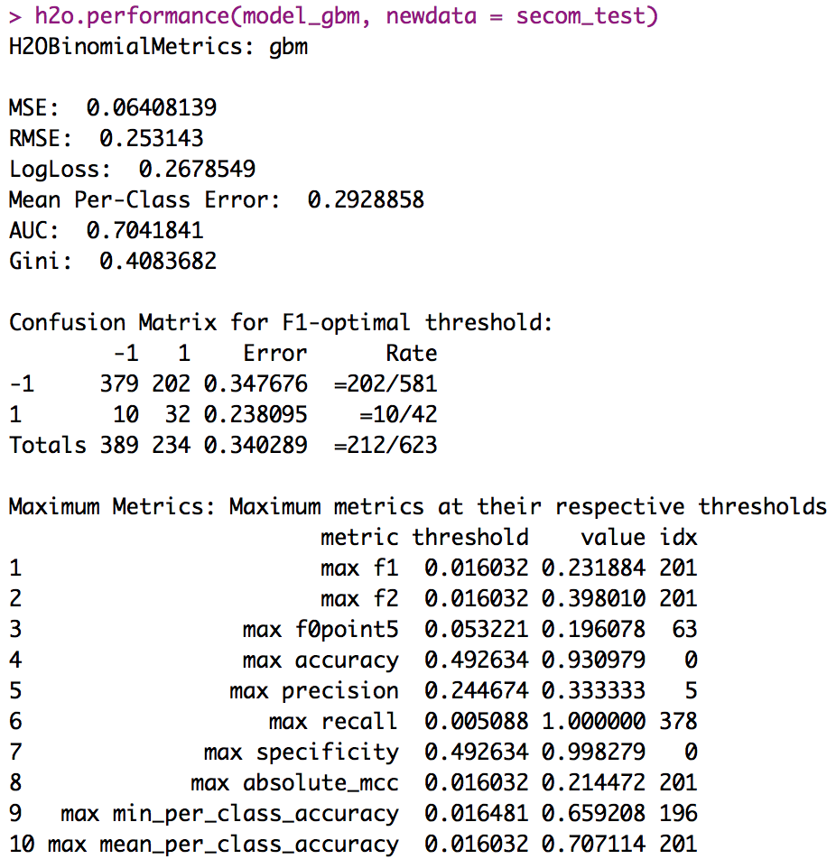
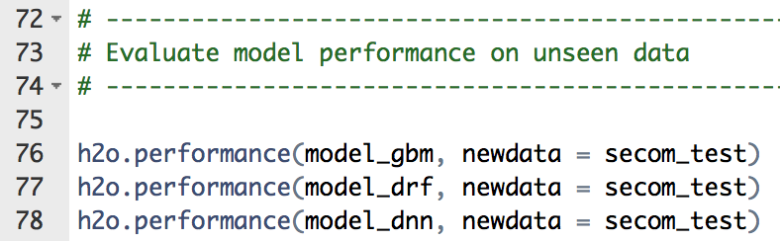
step_03_basic_models.R
Evaluate models with
test data

Slide 23
Advanced Procedures
Step 4 – Manual Tuning
Step 5 – Early Stopping
Step 6 – Grid Search
Step 7 – Stacking Models (“h2oEnsemble”)
Step 8 – Saving/Loading Models
Please try them out later (bit.ly/h2o_milan_1)

Slide 24
Use Case 2:
Anomaly Detection

Slide 25

Anomaly (Outlier) Detection
Definition
Identification of items, events or observations which do not conform to an expected pattern or other items in a dataset.
Use Cases
Bank Fraud
Monitoring Manufacturing Lines
Machine Learning
Separate dataset and build different models
Photo credit: www.dbta.com

Slide 26
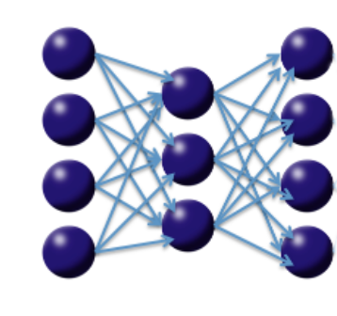
Deep Autoencoder for Anomaly Detection
Consider the following three-layer neural network with one hidden layer and the same number of input neurons (features) as output neurons.
The loss function is the mean squared error (MSE) between the input and the output. Hence, the network is forced to learn the identity via a nonlinear, reduced representation of the original data.
e.g. High MSE = potential outliers
Such an algorithm is called a deep autoencoder.
https://github.com/h2oai/h2o-training-book/blob/master/hands-on_training/anomaly_detection.md

Slide 27
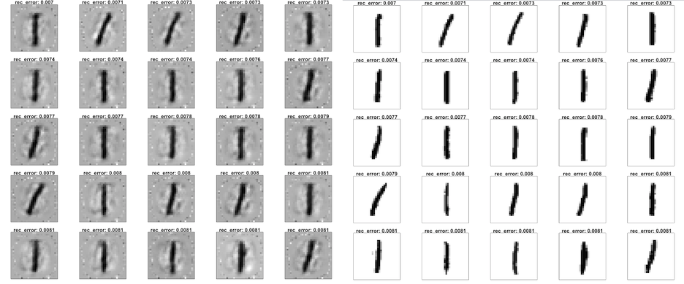
MNIST Example – The Good Ones
Samples with Low Mean Squared Error (MSE)

Slide 28
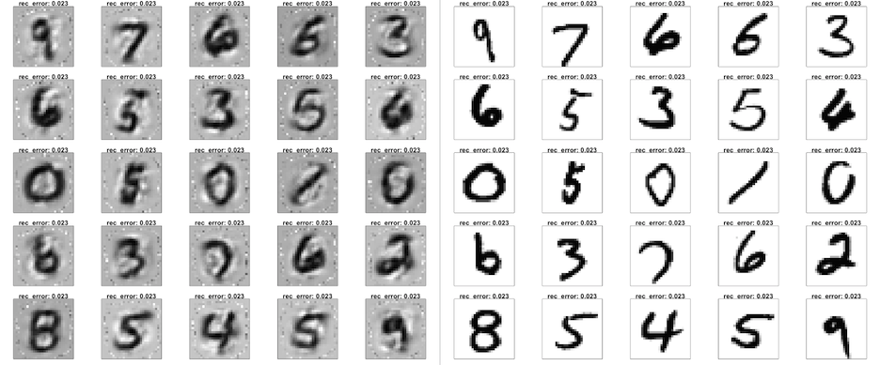
MNIST Example – The Bad Ones
Samples with High Mean Squared Error (MSE)

Slide 29
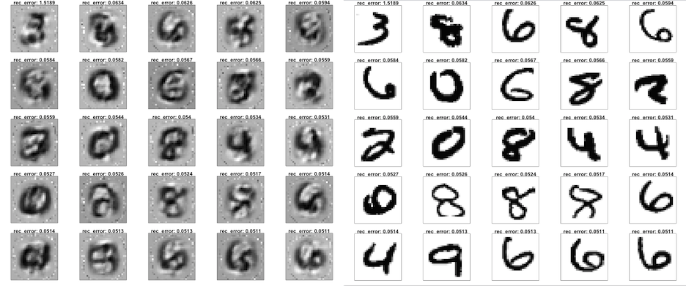
MNIST Example – The Ugly Ones
Samples with Highest Mean Squared Error (MSE)

Slide 30
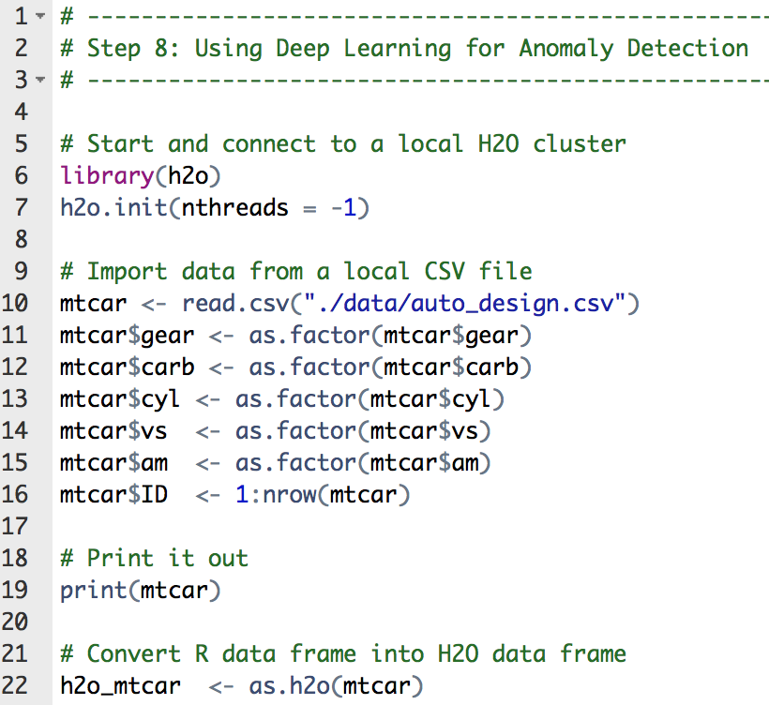
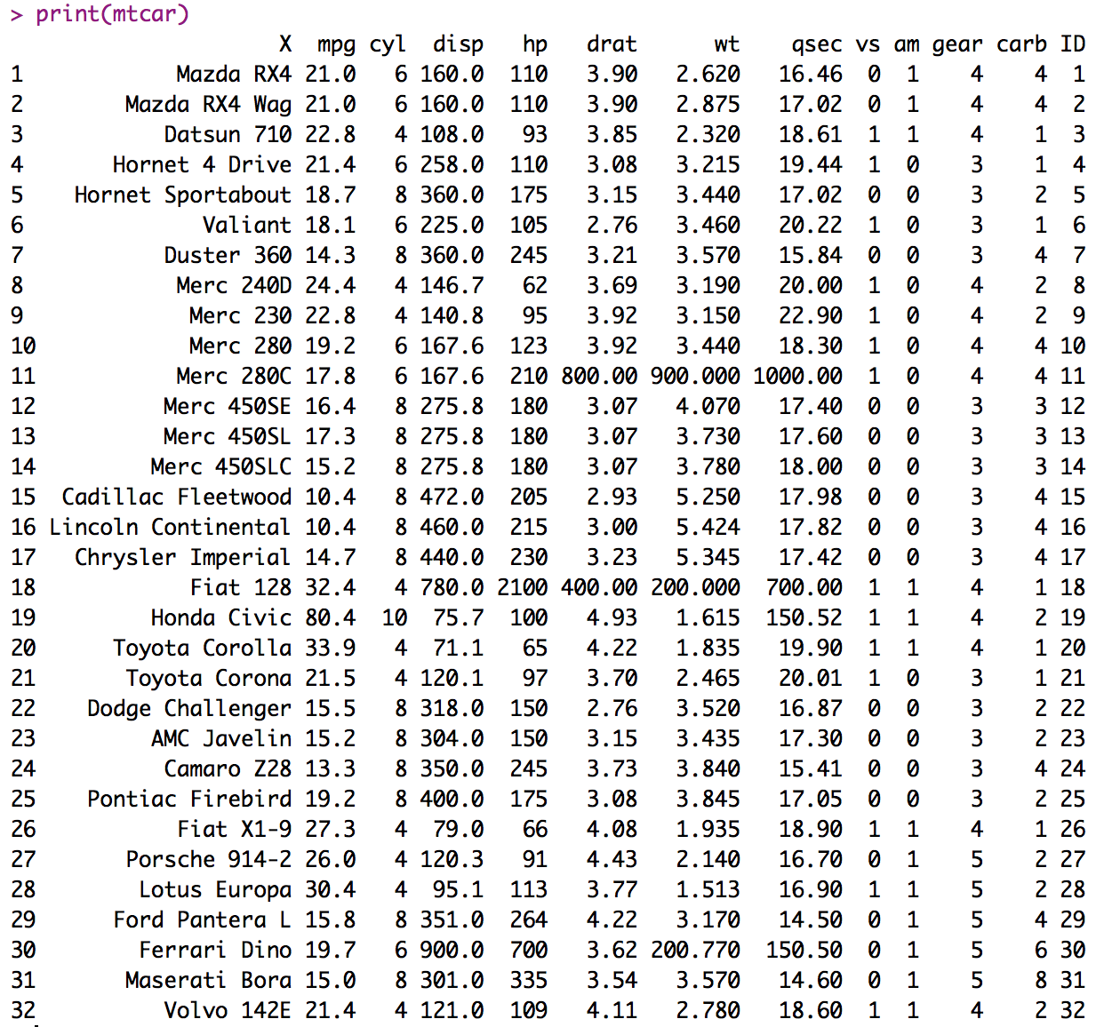
use_case_2_anomaly_detection.R

Slide 31
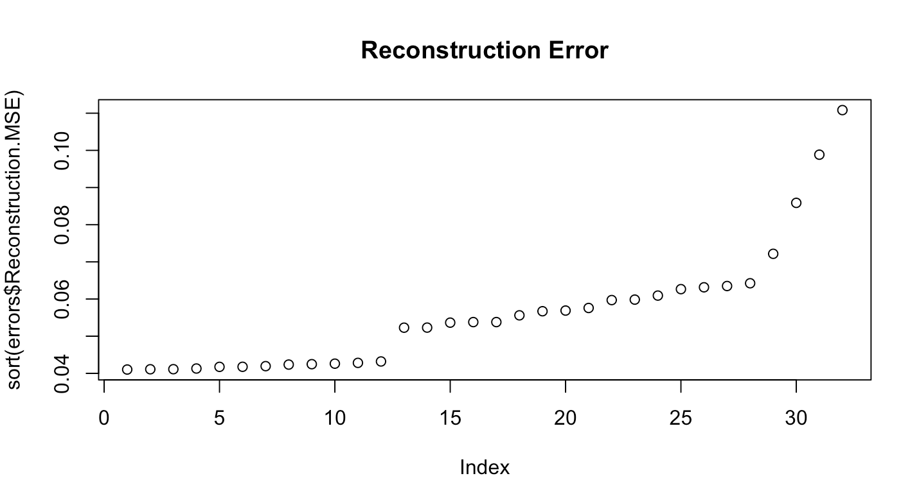
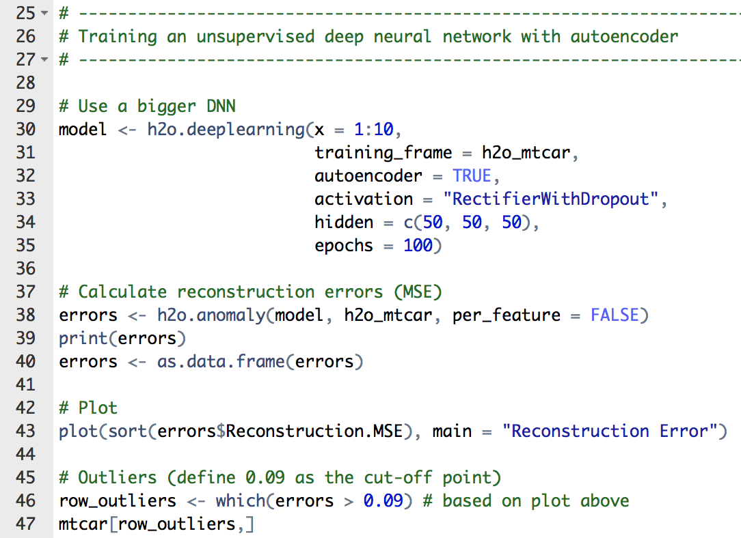
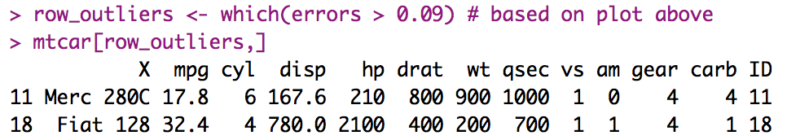
use_case_2_anomaly_detection.R
Build a Deep Autoencoder
Define your own cut-off point
Look at the MSE
Define cut-off
Outliers identified

Slide 32
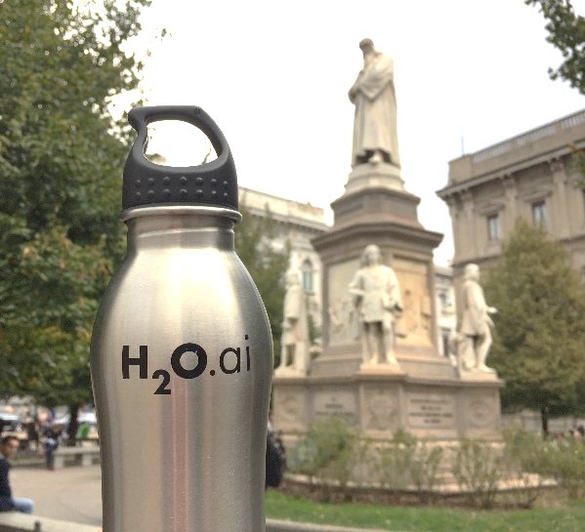
End of Second Talk – Thanks!
Data Science Milan
Gianmario Spacagna
Politecnico di Milano
Resources
bit.ly/h2o_milan_1
www.h2o.ai
docs.h2o.ai
Contact
joe@h2o.ai
@matlabulous
github.com/woobe

